Slide 1

Accessibility For Digital Contents & Services
Subash Acharya
03/14/2022

Slide 2
Importance Of Digital Accessibility
Background:
Nearly 20% (every 1 in 5) people in the world have some sort of disability.
71% of disabled users don’t use website or application simply because digital content is not accessible.
Last year, more then 2000 websites accessibility lawsuits were filed by plaintiffs because they were not ADA (American Disability Act) complaint.
Laws & Regulations:
Section 508 of the Rehabilitation Act of 1973 (29 U.S.C § 794 d) requires federal agencies in the United States to ensure that their electronic and information technology – including websites, web applications, software, and digital documents – is accessible to everyone.
American with disability act of 1990 (ADA) covers equal and fair treatment to disable users. All websites that fall under the category of ‘Public Accommodations’ – i.e., businesses that are open to the general public – will need to comply with Title III of the ADA

Slide 3
Problems Statement:
We share digital information or provide digital services to reach out to as many users as possible. Unfortunately, certain people with disabilities cannot get that information or services we want to provide. This is against our mission &/or vision. Information or services should be accessible to all irrespective to their physical or medical condition.
Persona:
User is a disabled individual who wants to access web sites to get information. Because of lack of accessibility in that web page. User has hard time getting information s/he needs. User is disappointed and sad because s/he is not able to get information s/he needs.
HMW Statement:
Digital Accessibility is important for disabled individual to get information they need whether it is digital services or content. Disability can be temporary or permanent, so it includes wide range of people. During interview I was able to talk with six people with different disabilities. While addressing accessibility issue we need to address for different accessibility groups. For example, problem for blind people are different from problems for deaf people. Improving accessibility is not feature, it is the law.

Slide 4
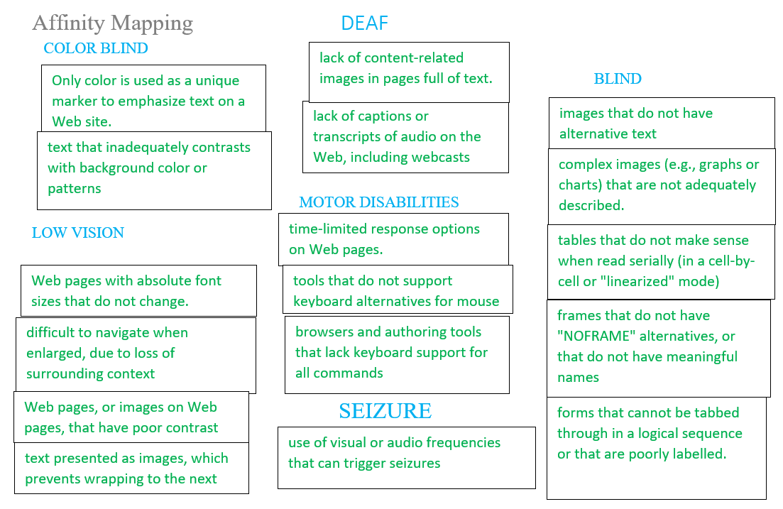

Slide 5
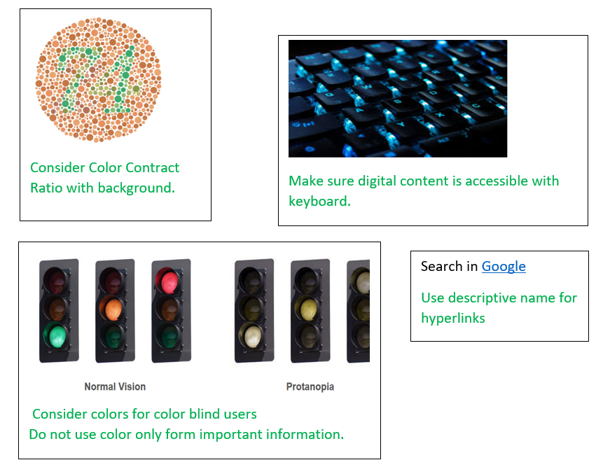
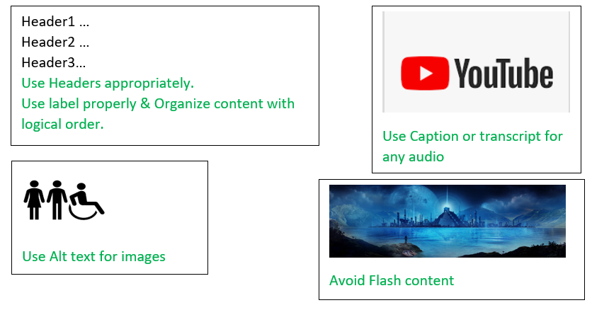
Sketch

Slide 6
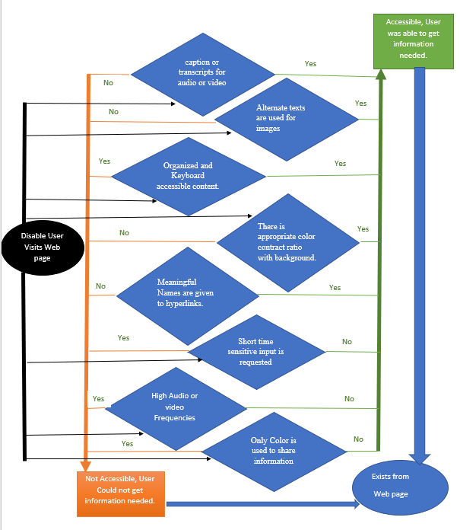
User
Flow
Diagram

Slide 7
Story Arc
Introduction: Digital accessibility is important to share information &/or services for all including disable users to reach out to more users.
Incident: Disable individuals have issue with getting information they need because of lack of accessibility.
Raising Action: There are some instances of lawsuit action because of accessibility issue.
Climax: There are laws to make digital content & services accessible.
Resolution: We have technologies and best practices in place that need to be addressed at early phase of project. If possible, all disable groups should be addressed.
Conclusion: We must consider accessibility while developing digital content or services.

Slide 8
Service Experience
Improve experience of team members who are developing, enhancing or maintaining digital information and services.
Improve experience of disabled individuals while accessing digital information or services.

Slide 9
Wireframe & Prototype
Please check Wireframe & Prototype in Figma
For detail Document Please check AccessibilityForDigitalContent&Services
ANY QUESTIONS ?

